Slide 1



Potential Methods for Augmenting Data
AFRL Scholars, Eglin AFB
6/26/23 – 7/7/23
Caleb Fryer

Slide 2
Agenda
Introduction
Update
GANs
Project Agenda
Questions

Slide 3
Introduction
Overall Objective: Observe the failure conditions of a munition due to its Velocity and Angle of Obliquity
3

Slide 4
Introduction
Project Objective: Develop a machine learning model that learns the relationship between the object’s velocity and angle of obliquity to its resulting strain distribution
Purpose: Reduce simulation time and overall cost of munitions development
4

Slide 5

Bimontly Progress Update
The past two weeks have been dedicated to preparing for project data:
Getting Access to STARNet
Accessing required coding programs and libraries through the STARNet system
Practiced writing code for loading and graphing Tensor Data
Researched GANs to determine an effective means of augmenting more data for the model
5

Slide 6
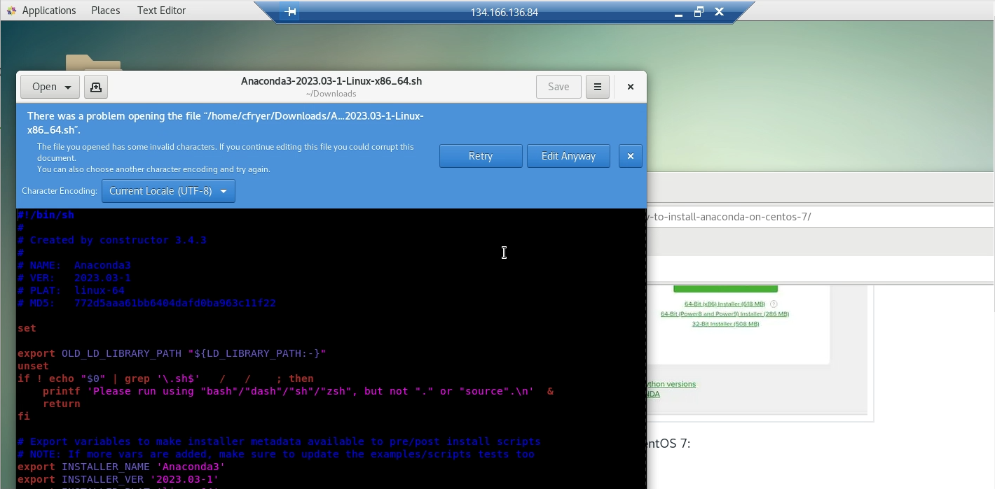
STARNet Access

Slide 7
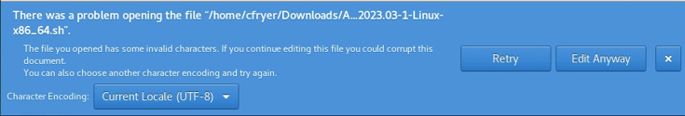
STARNet Access

Slide 8
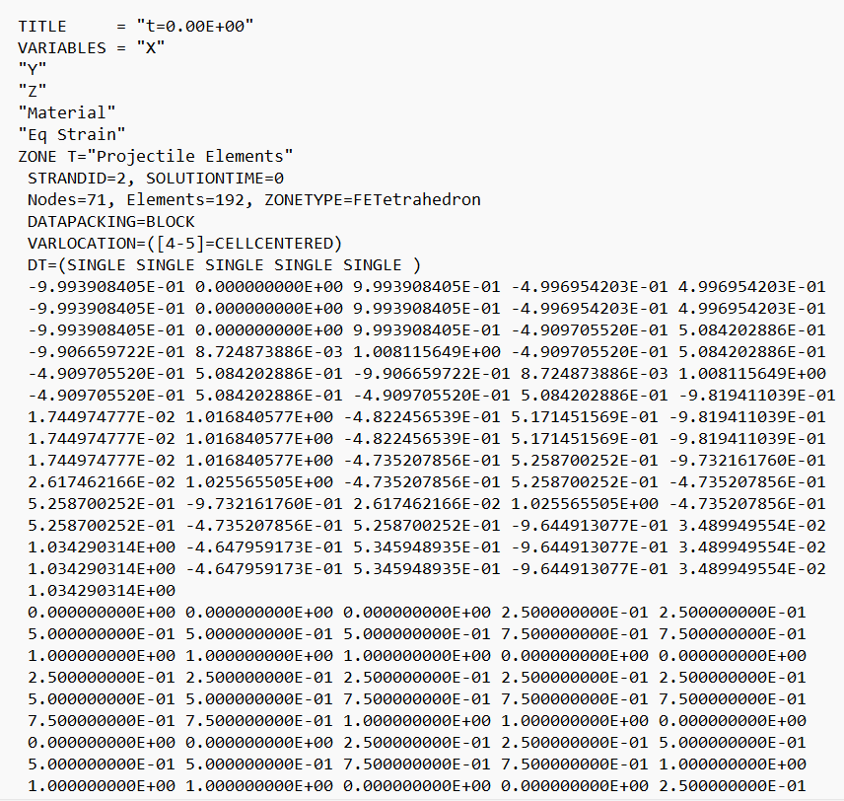
Organizing Tensor Data
Objective:
Create a general code for loading graphical data relevant to the project
Results:
Code demonstrated ability to graph nodes and faces of a toy box
Challenges:
Difficulty generalizing code
Further changes to code will depend on the organization and variables in the actual data for the project

Slide 9
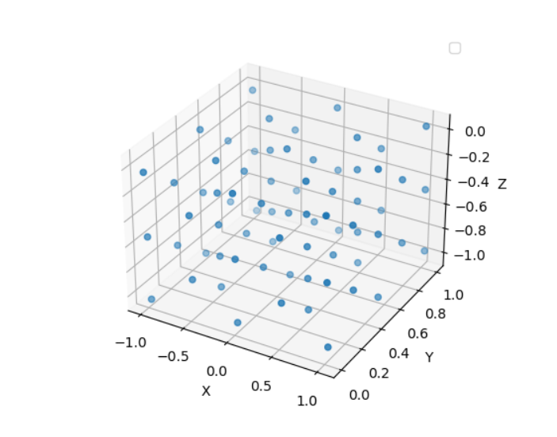
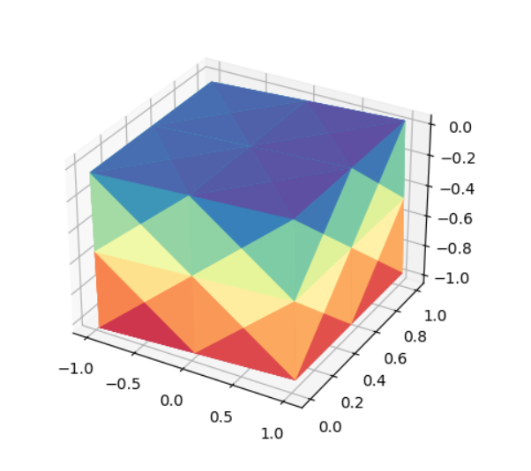
Organizing Tensor Data
Objective:
Create a general code for loading graphical data relevant to the project
Results:
Code demonstrated ability to graph nodes and faces of a toy box
Challenges:
Difficulty generalizing code
Further changes to code will depend on the organization and variables in the actual data for the project

Slide 10
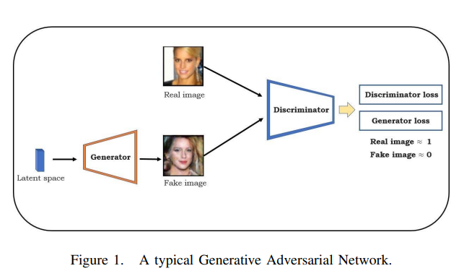
Generative Adversarial Networks GANs
A Machine Learning method with two competing models used to train a system
This is inherently unstable due to simultaneous dynamic training between the two models
Generator
Takes inputs from the latent space an generates fake images
Discriminator
Trained and challenged to learn relations if an image while also distinguishing between the real image (ground truth) and the generated image.

Slide 11
Potential Use of GANs for this Project
Latent Space Interpolation
Generator uses two inputs from the ground truth and develops

Slide 12
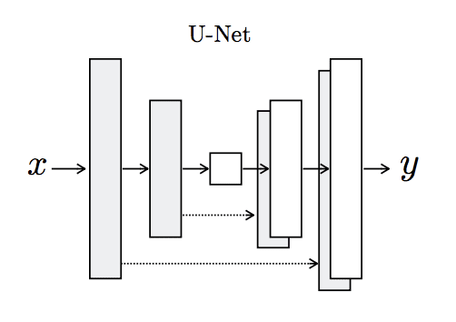
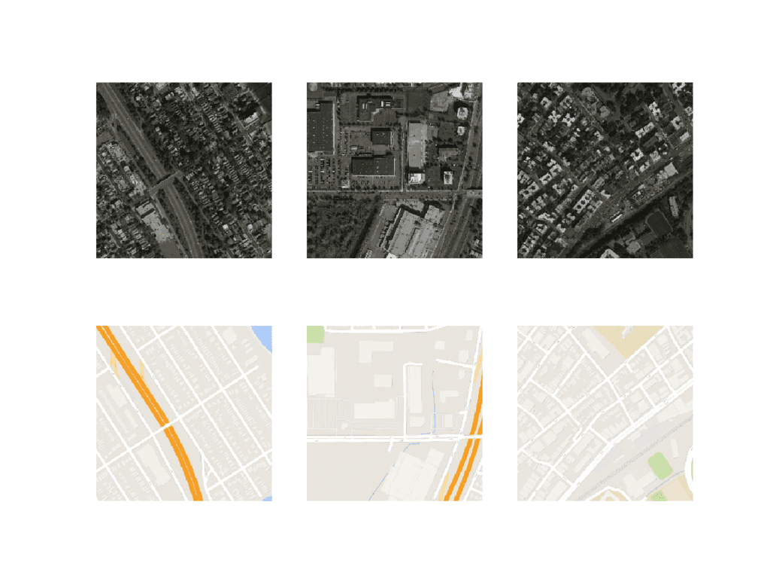
Potential Use of GANs for this Project
Pix2Pix
Converts a type of image into another type
Key Features: Encoder-Decoder Generator
U-type network architecture
Utilizes skip connections
May only be viable if additional data becomes available through a different program (like SolidWorks)

Slide 13
Plans for the next Two Weeks
Plan A:
July 10: Confirm with Stacey if Alex and Caleb will present together
July 17: Complete first draft of Poster and Presentation Slide
July 19: Turn in final draft of Poster and Presentation Slide
July 19 – 28: Continue refining code and presentation material
Aug 1-2: Presentation
Plan B: Work on the Fallback Plan

Slide 14
Fallback Plan
Without proper access to STARNet we cannot use the proper data for this project
We will likely have to create our own data
It is possible to convert SolidWorks files into .dat files
Could conduct a series of drop tests for a toy box to generate usable data for our codes

Slide 15
Questions?

Slide 16
Thank you

